Slide 1
QC-MDPC (BIKE)
Failure Analysis Survey
Ray Perlner

Slide 2
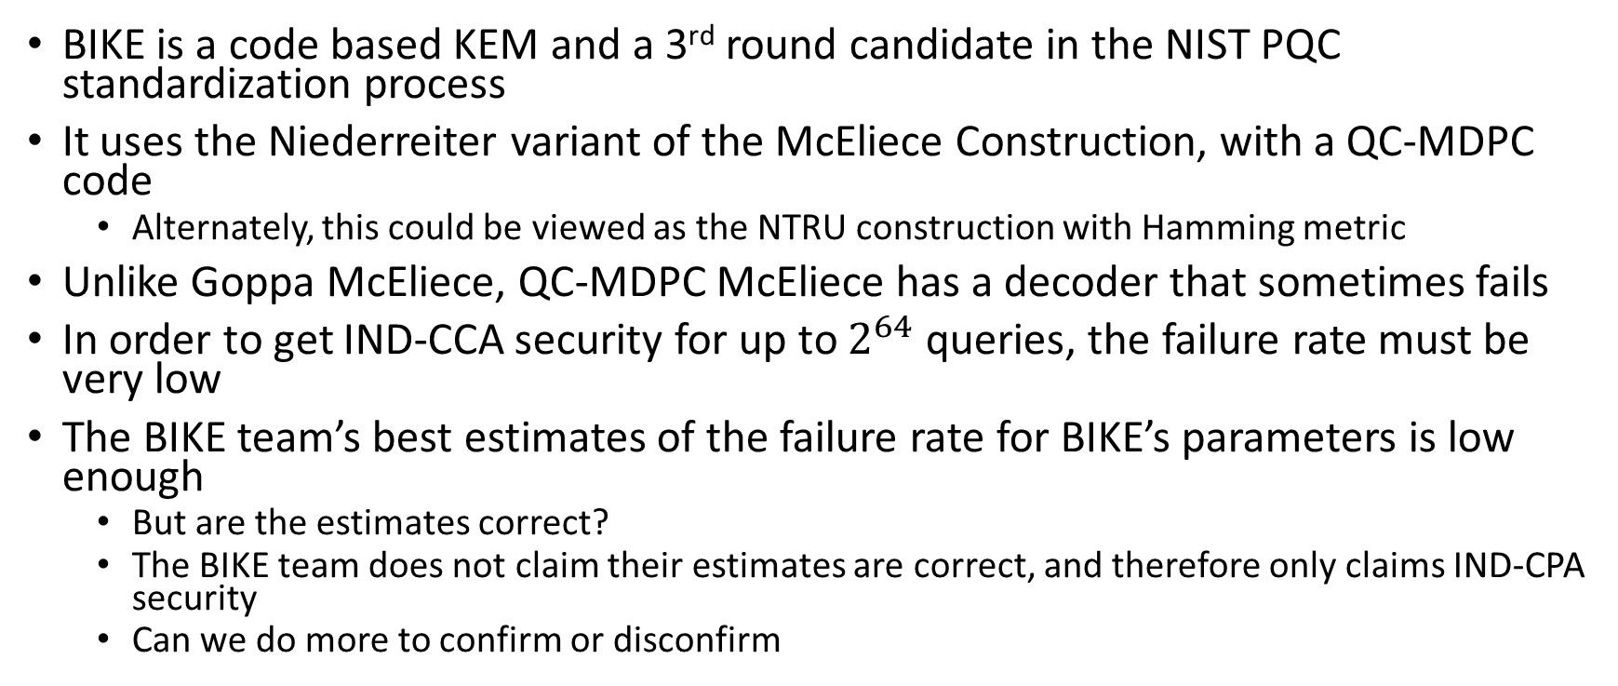
Overview
BIKE is a code based KEM and a 3rd round candidate in the NIST PQC standardization process
It uses the Niederreiter variant of the McEliece Construction, with a QC-MDPC code
  Alternately, this could be viewed as the NTRU construction with Hamming metric
Unlike Goppa McEliece, QC-MDPC McEliece has a decoder that sometimes fails
In order to get IND-CCA security for up to $2^{64}$ queries, the failure rate must be very low
The BIKE team’s best estimates of the failure rate for BIKE’s parameters is low enough
  But are the estimates correct?
  The BIKE team does not claim their estimates are correct, and therefore only claims IND-CPA security
  Can we do more to confirm or disconfirm

Slide 3
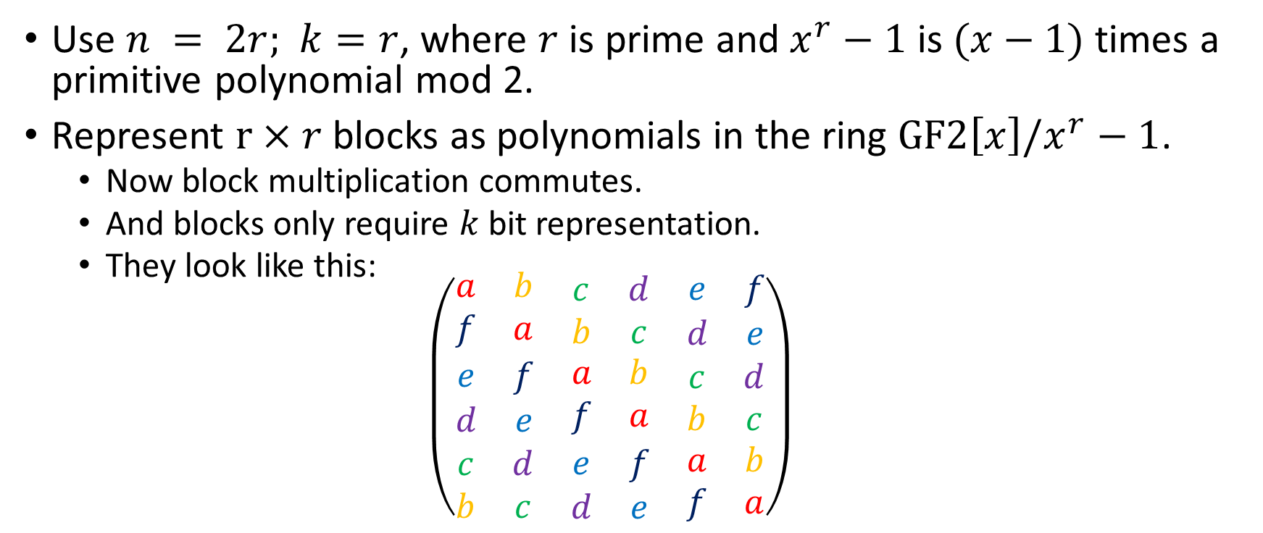
Quasi-Cyclic Structure
Use $n = 2r;$ $k=r$, where $r$ is prime and $x^{r}−1$ is $(x−1)$times a primitive polynomial mod 2.
Represent $r×r$ blocks as polynomials in the ring $GF2\left[x\right]/x^{r}−1$.
  Now block multiplication commutes.
  And blocks only require $k$ bit representation.
  They look like this:
  $$\left(\begin{matrix}\begin{matrix}a & b \\ f & a\end{matrix} & \begin{matrix}c & d \\ b & c\end{matrix} & \begin{matrix}e & f \\ d & e\end{matrix} \\ \begin{matrix}e & f \\ d & e\end{matrix} & \begin{matrix}a & b \\ f & a\end{matrix} & \begin{matrix}c & d \\ b & c\end{matrix} \\ \begin{matrix}c & d \\ b & c\end{matrix} & \begin{matrix}e & f \\ d & e\end{matrix} & \begin{matrix}a & b \\ f & a\end{matrix}\end{matrix}\right)$$

Slide 4
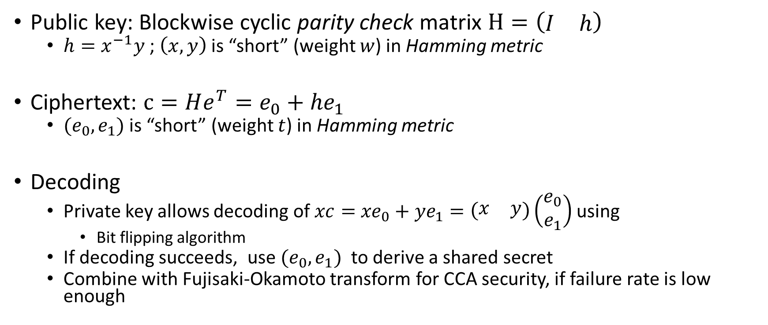
BIKE Construction
(Niederreiter)
Public key: Blockwise cyclic parity check matrix $H=\left(\begin{matrix}I & h\end{matrix}\right)$
  $h=x^{−1}y$ ; $\left(x,y\right)$ is “short” (weight $w$) in Hamming metric
Ciphertext: $c=He^{T}=e_{0}+{he}_{1}$
  $(e_{0},e_{1})$ is “short” (weight $t$) in Hamming metric
Decoding
  Private key allows decoding of $xc=$ ${xe}_{0}+{ye}_{1}=\left(\begin{matrix}x & y\end{matrix}\right)\left(\begin{matrix}e_{0} \\ e_{1}\end{matrix}\right)$ using
    Bit flipping algorithm
  If decoding succeeds, use $(e_{0},e_{1})$ to derive a shared secret
  Combine with Fujisaki-Okamoto transform for CCA security, if failure rate is low enough

Slide 5

BIKE Parameters
Note:
  $w$ and $t$ are approximately equal to the security parameter
  $r≈\frac{wt}{2}$
  To lower the DFR, increase $r$, while fixing $w$, $t$

Slide 6
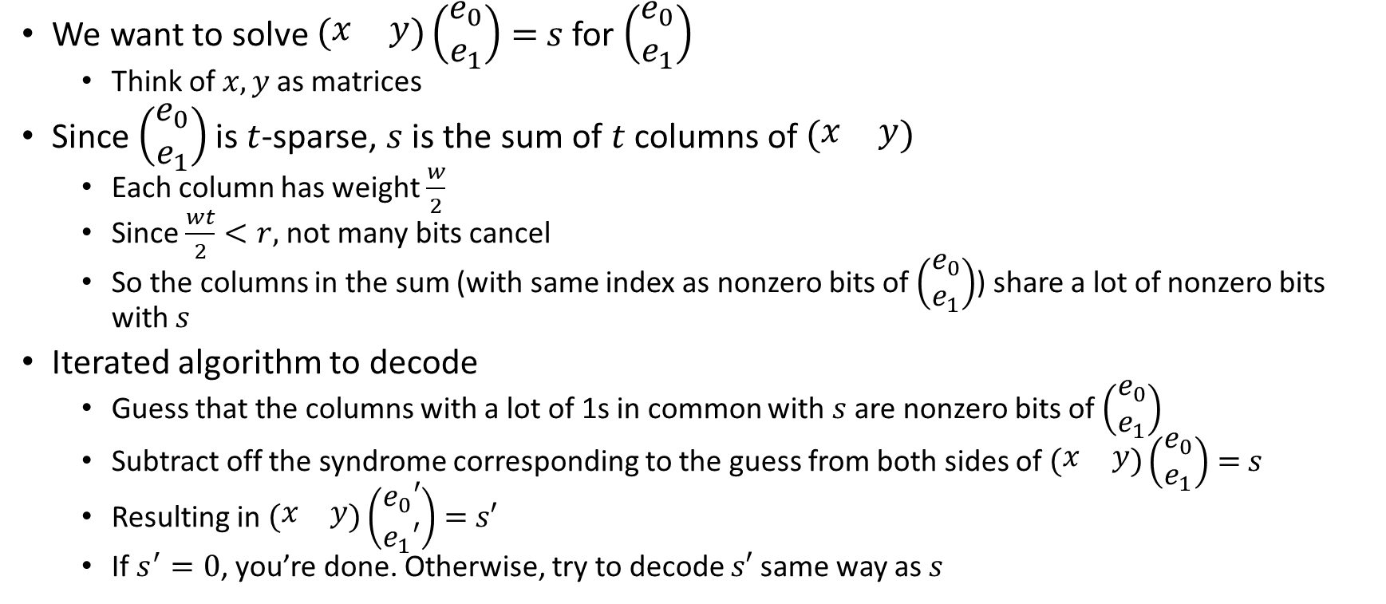
Bit-Flipping Decoder
We want to solve $\left(\begin{matrix}x & y\end{matrix}\right)\left(\begin{matrix}e_{0} \\ e_{1}\end{matrix}\right)=$ $s$ for $\left(\begin{matrix}e_{0} \\ e_{1}\end{matrix}\right)$
  Think of $x, y$as matrices
Since $\left(\begin{matrix}e_{0} \\ e_{1}\end{matrix}\right)$ is $t$-sparse, $s$ is the sum of $t$ columns of $\left(\begin{matrix}x & y\end{matrix}\right)$
  Each column has weight $\frac{w}{2}$
  Since $\frac{wt}{2}<r,$ not many bits cancel
  So the columns in the sum (with same index as nonzero bits of $\left(\begin{matrix}e_{0} \\ e_{1}\end{matrix}\right)$) share a lot of nonzero bits with $s$
Iterated algorithm to decode
  Guess that the columns with a lot of 1s in common with $s$ are nonzero bits of $\left(\begin{matrix}e_{0} \\ e_{1}\end{matrix}\right)$
  Subtract off the syndrome corresponding to the guess from both sides of $\left(\begin{matrix}x & y\end{matrix}\right)\left(\begin{matrix}e_{0} \\ e_{1}\end{matrix}\right)=$ $s$
  Resulting in $\left(\begin{matrix}x & y\end{matrix}\right)\left(\begin{matrix}e_{0}′ \\ e_{1}′\end{matrix}\right)=$ $s′$
  If $s^{′}=0$, you’re done. Otherwise, try to decode $s′$ same way as $s$

Slide 7
Other Decoders
Many variants of the basic bit flipping decoder have been proposed
  Backflip decoder (2nd round) [Sendrier, Vasseur 2019]
  Black-Grey-Flip (BGF) decoder (pre-3rd round) [Drucker, Gueron, Kostic 2019]
Usually the motivation is a lower decryption failure rate
However, all decoders work on a similar principle to bit flipping
No proposed parameter set claims a zero decryption failure
  As we’ll see later, the DFR cannot be 0
Why are decryption failures bad?

Slide 8
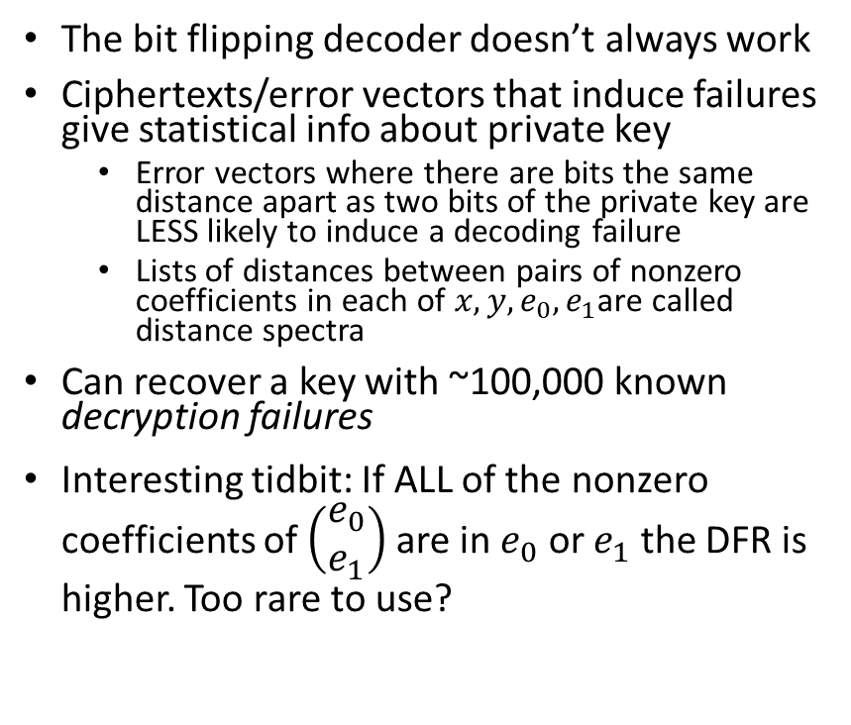
GJS attack
[Guo, Johansson, Stankovski 2016]
The bit flipping decoder doesn’t always work
Ciphertexts/error vectors that induce failures give statistical info about private key
  Error vectors where there are bits the same distance apart as two bits of the private key are LESS likely to induce a decoding failure
  Lists of distances between pairs of nonzero coefficients in each of $x,y,e_{0},e_{1}$are called distance spectra
Can recover a key with ~100,000 known decryption failures
Interesting tidbit: If ALL of the nonzero coefficients of $\left(\begin{matrix}e_{0} \\ e_{1}\end{matrix}\right)$ are in $e_{0}$ or $e_{1}$ the DFR is higher. Too rare to use?

Slide 9
Error Amplification
[Nilsson, Johansson, Wagner 2018]
Builds upon distance spectrum idea from GJS attack
Can use a known decryption failure to build other ciphertexts more likely to produce a decryption failure
  This means that the majority of the cost of the attack involves finding the first decryption failure
If the number of iterations to used to decode is variable, that side channel information can be used to speed up finding the first decryption failure
  We think BIKE’s current implementation is constant time, and if we discover it isn’t, we will expect them to fix it

Slide 10
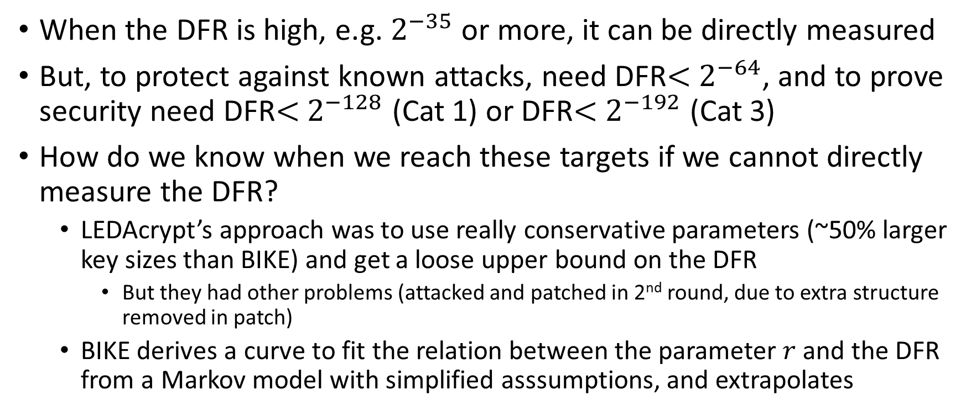
Bounding the Error Rate
When the DFR is high, e.g. $2^{−35}$ or more, it can be directly measured
But, to protect against known attacks, need DFR$<$ $2^{−64}$, and to prove security need DFR$<$ $2^{−128}$ (Cat 1) or DFR$<$ $2^{−192}$ (Cat 3)
How do we know when we reach these targets if we cannot directly measure the DFR?
  LEDAcrypt’s approach was to use really conservative parameters (~50% larger key sizes than BIKE) and get a loose upper bound on the DFR
    But they had other problems (attacked and patched in 2nd round, due to extra structure removed in patch)
  BIKE derives a curve to fit the relation between the parameter $r$ and the DFR from a Markov model with simplified asssumptions, and extrapolates

Slide 11
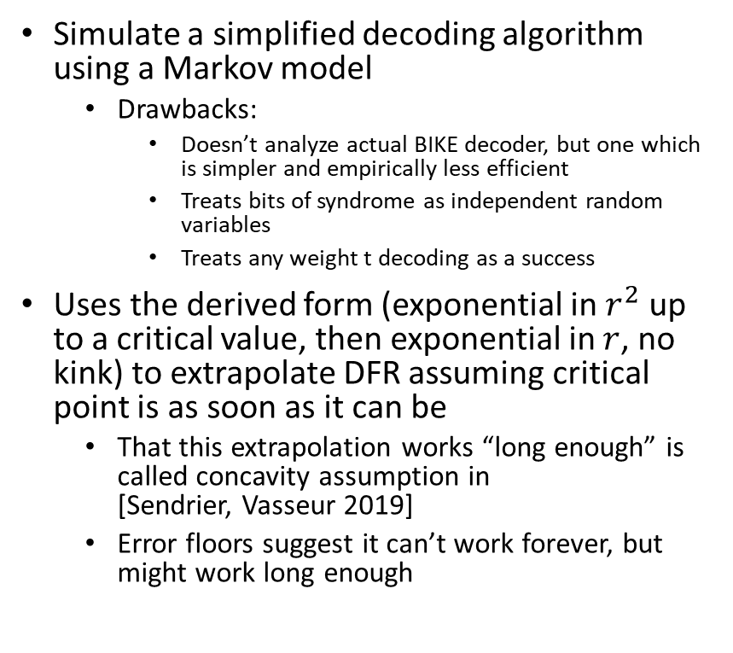
Markov Model and Extrapolation
[Sendrier, Vasseur 2018], [Sendrier, Vasseur 2019], [Drucker, Gueron, Kostic 2019]
Simulate a simplified decoding algorithm using a Markov model
  Drawbacks:
    Doesn’t analyze actual BIKE decoder, but one which is simpler and empirically less efficient
    Treats bits of syndrome as independent random variables
    Treats any weight t decoding as a success
Uses the derived form (exponential in $r^{2}$ up to a critical value, then exponential in $r$, no kink) to extrapolate DFR assuming critical point is as soon as it can be
  That this extrapolation works “long enough” is called concavity assumption in [Sendrier, Vasseur 2019]
  Error floors suggest it can’t work forever, but might work long enough

Slide 12
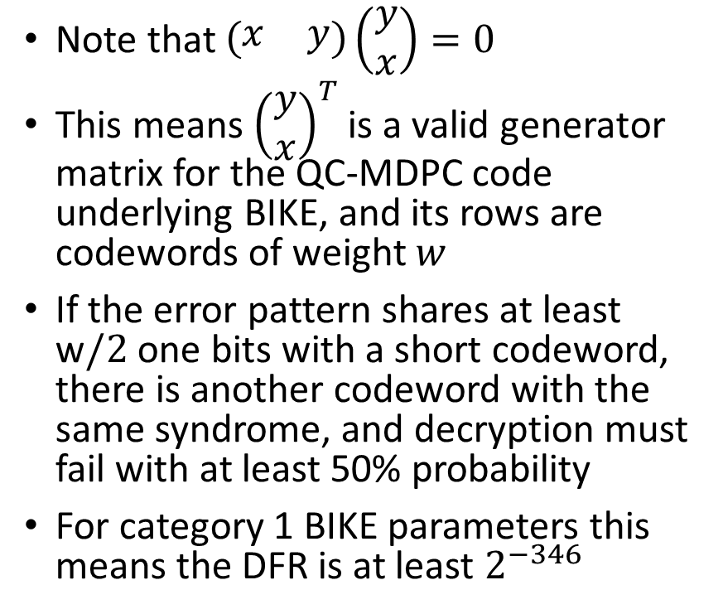
Error Floors
Image on right from [Richardson] illustrating similar phenomenon in related code to BIKE
Note that $\left(\begin{matrix}x & y\end{matrix}\right)\left(\begin{matrix}y \\ x\end{matrix}\right)=0$
This means ${\left(\begin{matrix}y \\ x\end{matrix}\right)}^{T}$ is a valid generator matrix for the QC-MDPC code underlying BIKE, and its rows are codewords of weight $w$
If the error pattern shares at least w$/2$ one bits with a short codeword, there is another codeword with the same syndrome, and decryption must fail with at least 50% probability
For category 1 BIKE parameters this means the DFR is at least $2^{−346}$

Slide 13
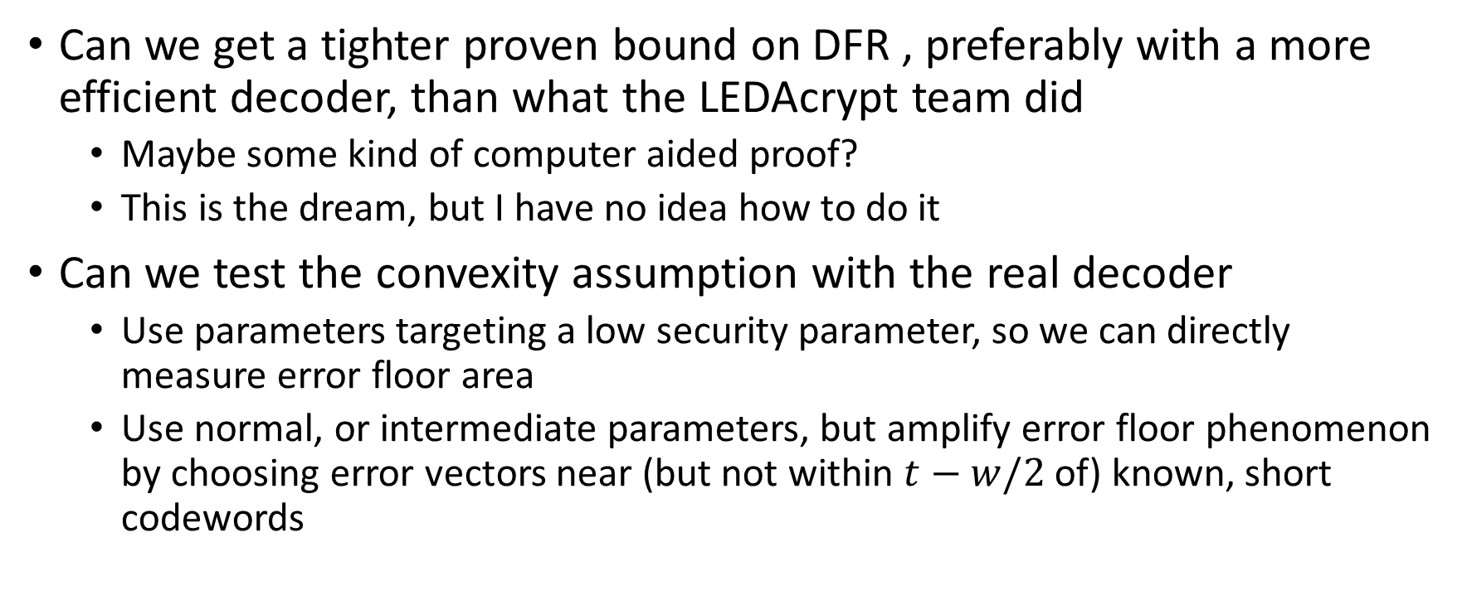
Directions for Future Work
Can we get a tighter proven bound on DFR , preferably with a more efficient decoder, than what the LEDAcrypt team did
  Maybe some kind of computer aided proof?
  This is the dream, but I have no idea how to do it
Can we test the convexity assumption with the real decoder
  Use parameters targeting a low security parameter, so we can directly measure error floor area
  Use normal, or intermediate parameters, but amplify error floor phenomenon by choosing error vectors near (but not within $t−w/2$of) known, short codewords

Slide 14
References
Latest BIKE spec. https://bikesuite.org/files/v4.0/BIKE_Spec.2020.05.03.1.pdf
Reaction attack
  Guo, Johansson, Stankovski 2016: https://eprint.iacr.org/2016/858.pdf
Error Amplification
  Nilsson, Johansson, Wagner 2018: https://eprint.iacr.org/2018/1223.pdf
Estimating/bounding failure rate
  Markovian analysis (Simple decoder, infinite iterations)
    [Sendrier, Vasseur 2018]: https://eprint.iacr.org/2018/1207
  Extrapolation (Backflip decoder)
    [Sendrier, Vasseur 2019]: https://eprint.iacr.org/2019/1434.pdf
  Extrapolation (Black and Gray Decoder)
    [Drucker, Gueron, Kostic 2019]: https://eprint.iacr.org/2019/1423
  Explicit bounds for 1 (tight) or 2 (loose) iterations (IR BF Decoder)
    [Baldi et al. 2020] https://re.public.polimi.it/retrieve/handle/11311/1144467/513367/SECRYPT_2020_118_CR.pdf
Describing error floors (I don’t think this paper originated the idea):
    [Richardson]: https://web.stanford.edu/class/ee388/papers/ErrorFloors.pdf

